Slide 1
Sign-Up GEnius
An Online scheduling tool
Presentation Created by :
Brandi Laney

Slide 2
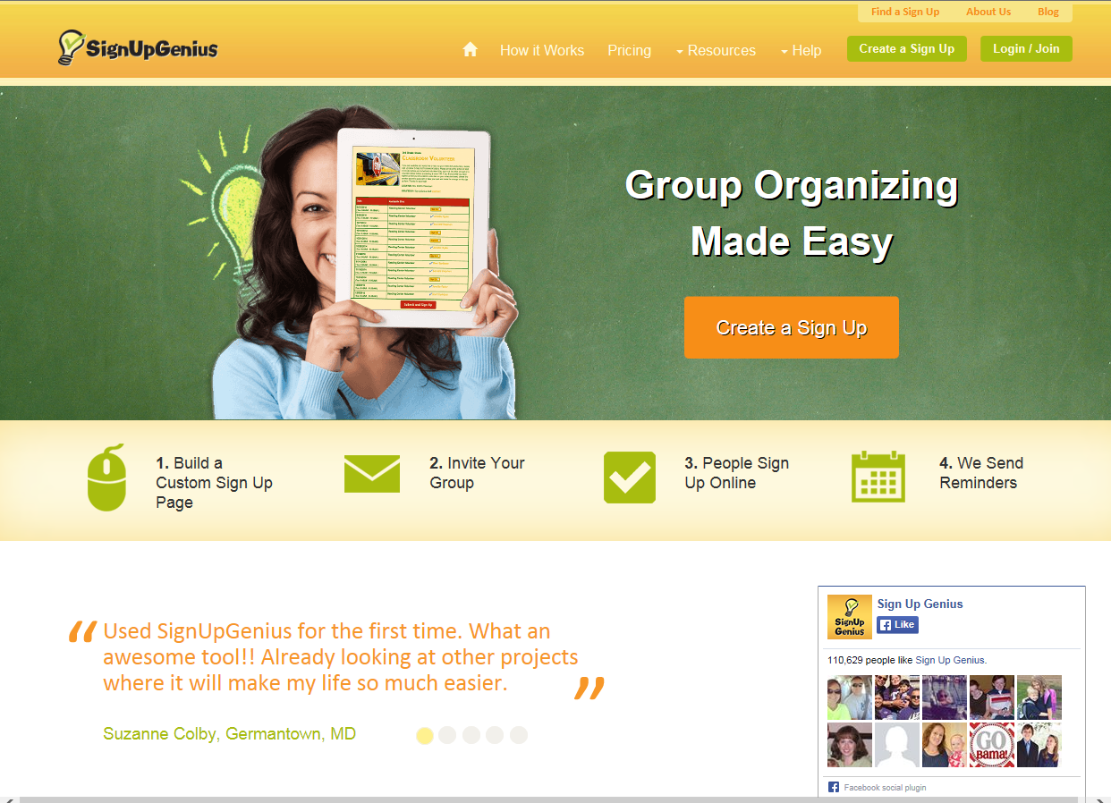
What is sign-up genius?
Sign-Up Genius is an online tool for organizing schedules. It can be used for parent conferences, student presentations, etc. Instead of sending paper forms back and forth to choose a date, confirm, remind…. This does it all for you. It is a quick and efficient. Parents love it because it only takes a second to sign-up. There is also an option to change your scheduled time, swap with someone else, or cancel without anyone getting confused. This is a tutorial on the free version, so there are ads. ☹ However, they are minimal, and the value of the program makes it all worth it.

Slide 3
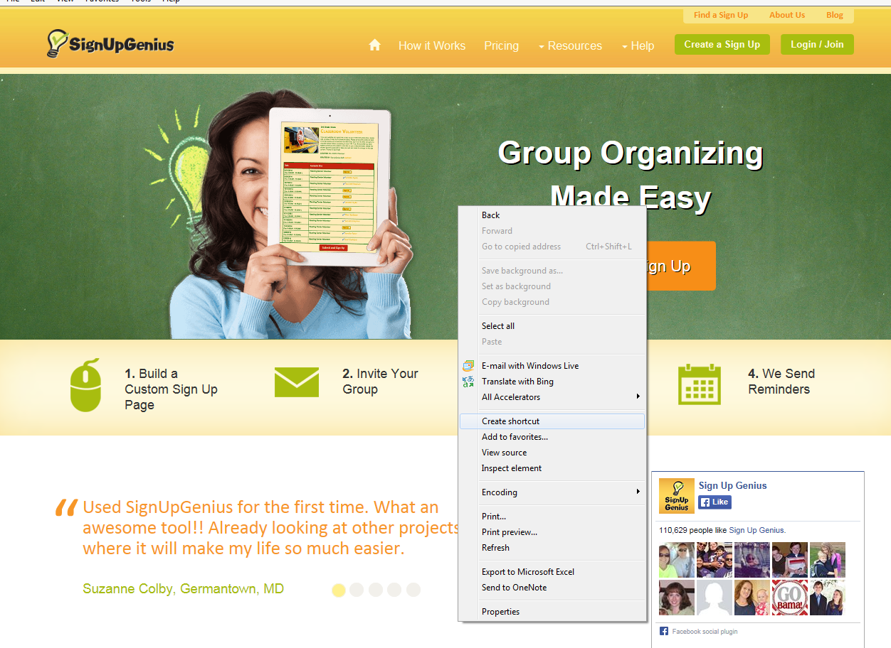
Signing -up or signing-in:
1. Go to the site http://www.signupgenius.com/
2. Create a short cut for your desktop by right-clicking anywhere in the screen, and selecting create a shortcut .

Slide 4
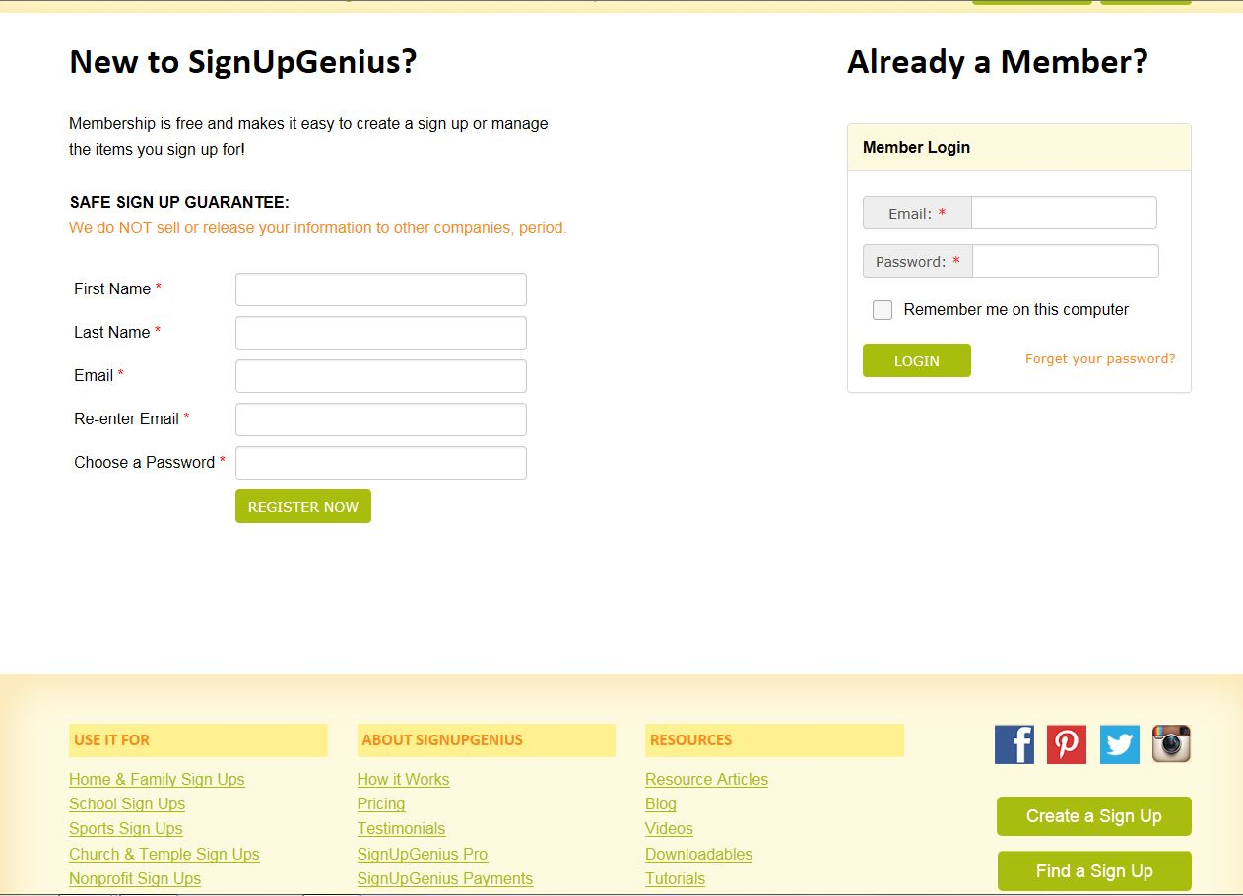
3. If this is your first visit, please follow steps 4-5 to set up an account. If you have an account, click “sign-in”.
4. Click on Sign-in/Join
5. Fill in the information for New to Sign-Up Genius, click Register Now
*Once logged in, your home screen will show sign-ups you are associated with.

Slide 5
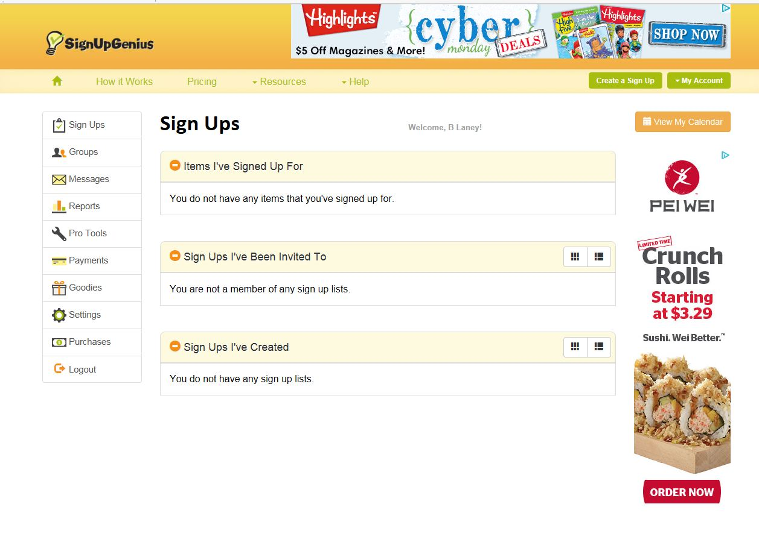
Creating a sign-up:
1. Click on Create Sign-Up at the top right of the screen.

Slide 6
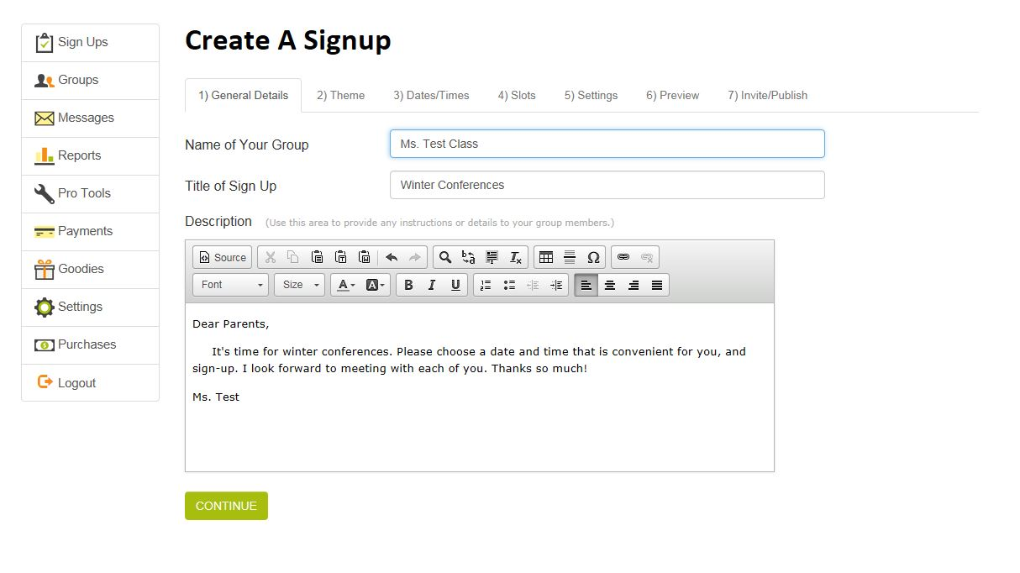
2. Fill in the information on the screen concerning the name of the event and teacher. You may also include a short message to your parents or group you are creating the sign-up for explaining the event.

Slide 7
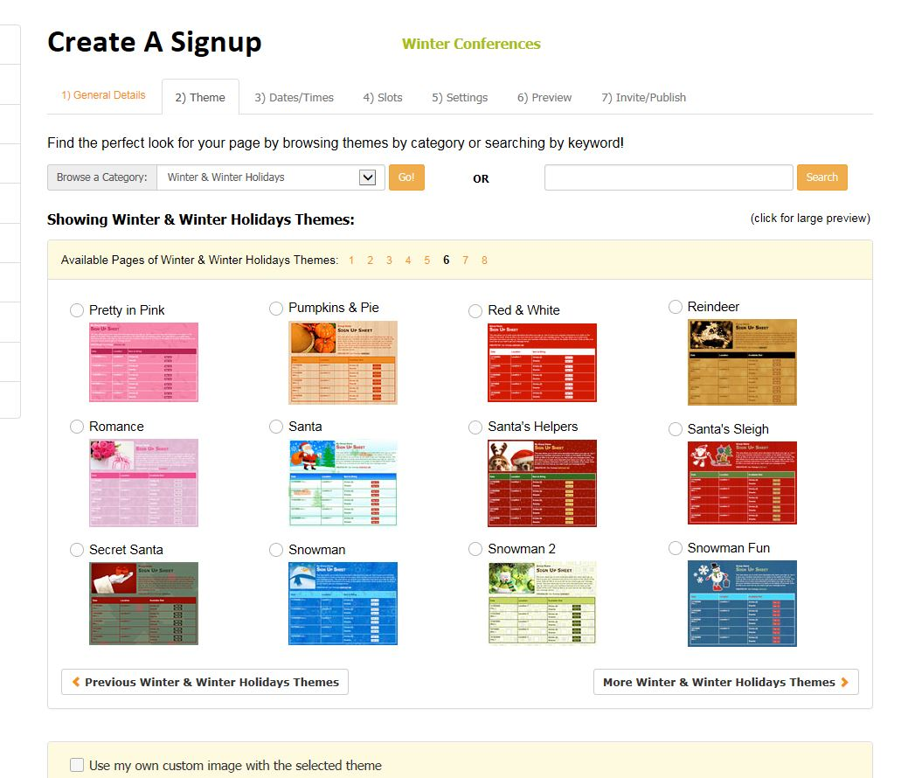
3. Choose a theme for your sign-up form. You may select a category to search from the drop down menu or if you may download and select an image of your own. Click continue.

Slide 8
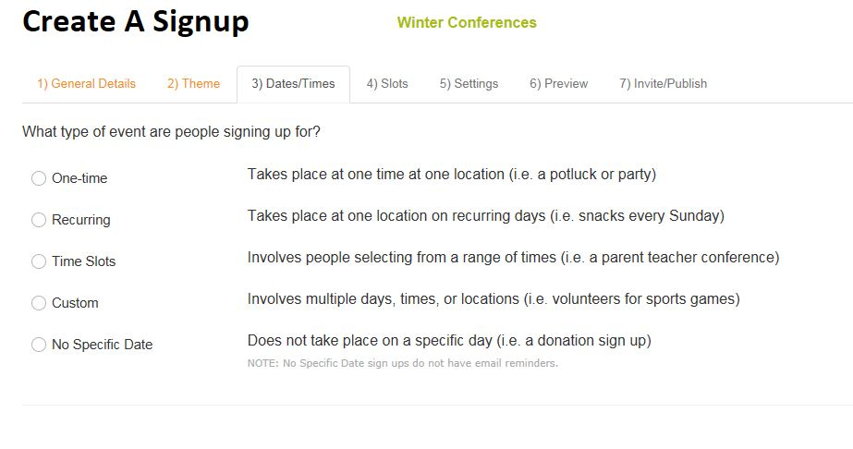
4. Choose the type of sign-up you wish to create, depending on what the event is. There are descriptions of each that may help you choose which one is most suitable.

Slide 9
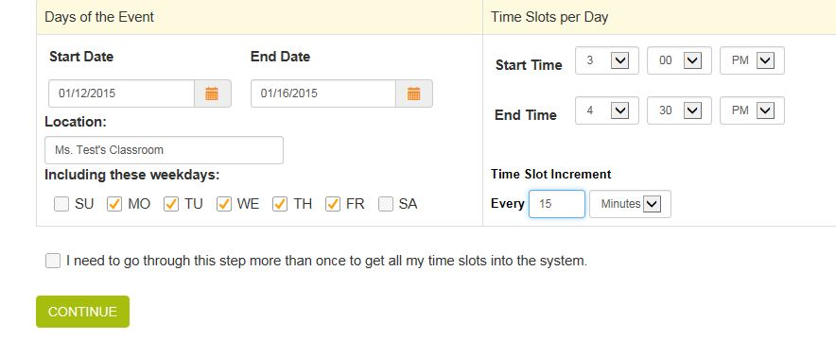
5. Begin entering your dates and times you wish to have available for sign-up. The following sample shows Mon-Fri, 3:00-4:30, every 15 minutes. Click continue.

Slide 10
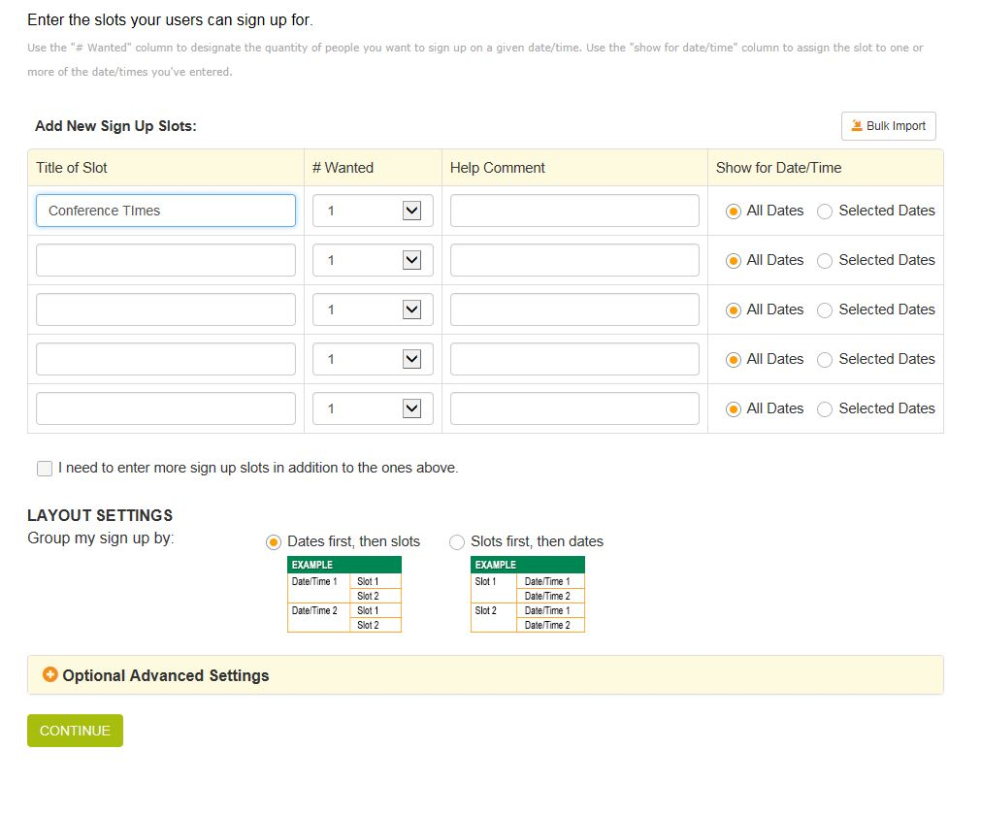
6. Enter what you would like the title of your column to be where people are signing-up, and how many available slots you would like to have for each time. The following sample shows the title “Conference Times” with just 1 person able to sign up per time slot. The circle is checked for all dates. Click continue.

Slide 11
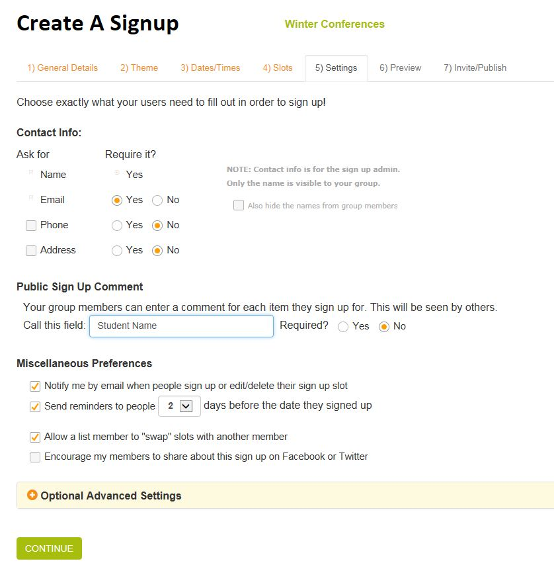
7. Select what information you would like required of the people signing-up. You can also select when you would like a reminder sent, if you want the participants to be able to swap, and if you would like an email sent to you. Click continue.

Slide 12
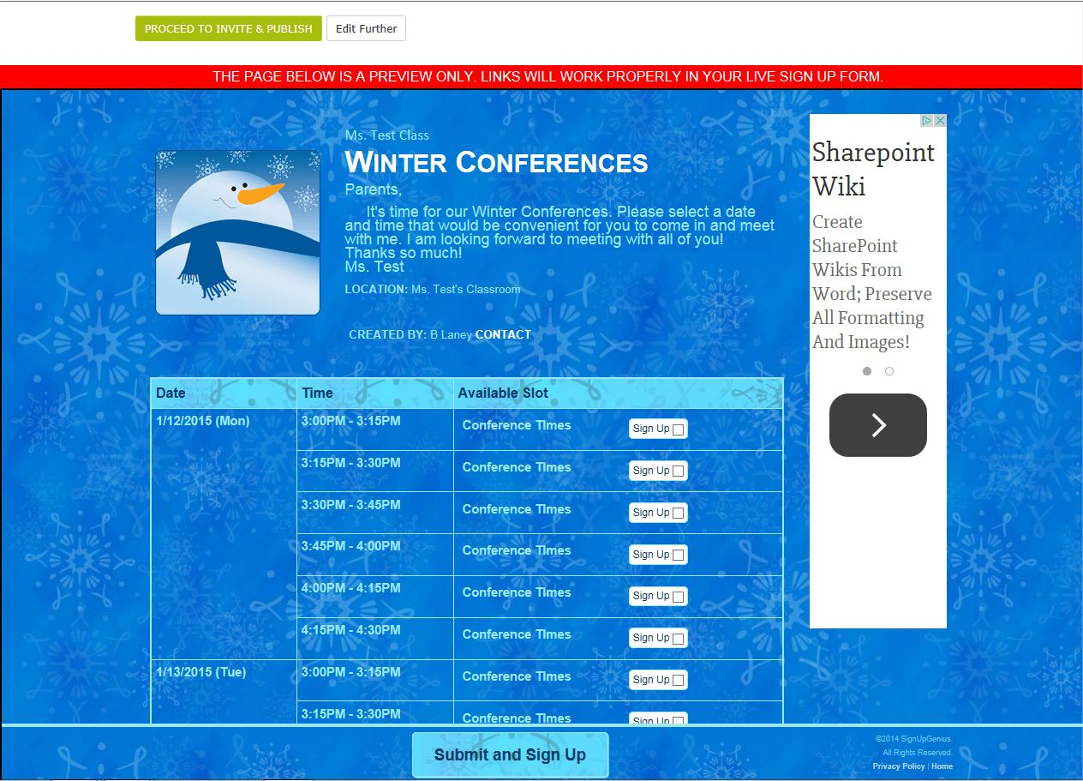
8. Check the preview form that has been created. If any editing needs to be done, click edit further. If everything looks good, you can click Proceed to Invite and Publish which will make it a live document for you to email out to your participants. (You can make changes even after it has been published.)

Slide 13
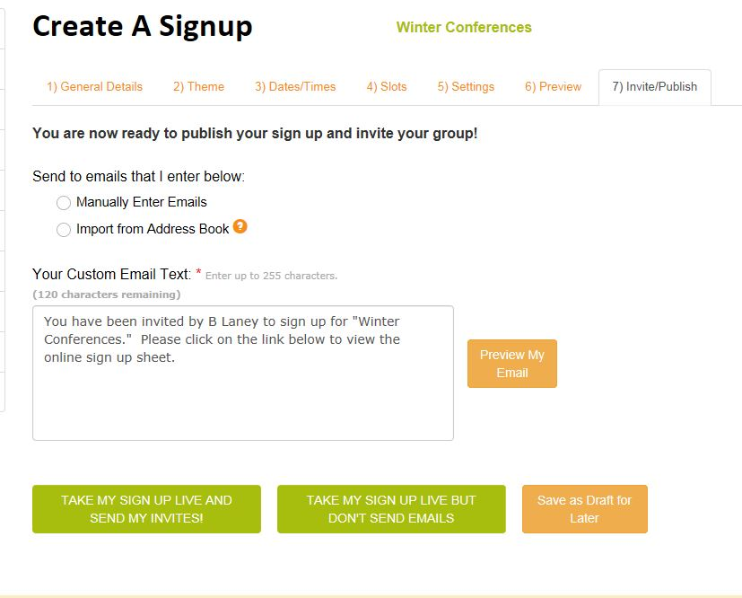
Inviting subscribers:
1. Once your form has been published, you can start inviting others to sign-up. You can either enter email addresses in manually or import them from an address book. I have a distribution list set up with all of my parents’ names already, so I simply enter my email address to have it sent first to me, then I forward it out to my parents.
2. Choose the option of publishing the form and sending the email, or publishing the form only and not sending the email. You can also save it as a draft.

Slide 14
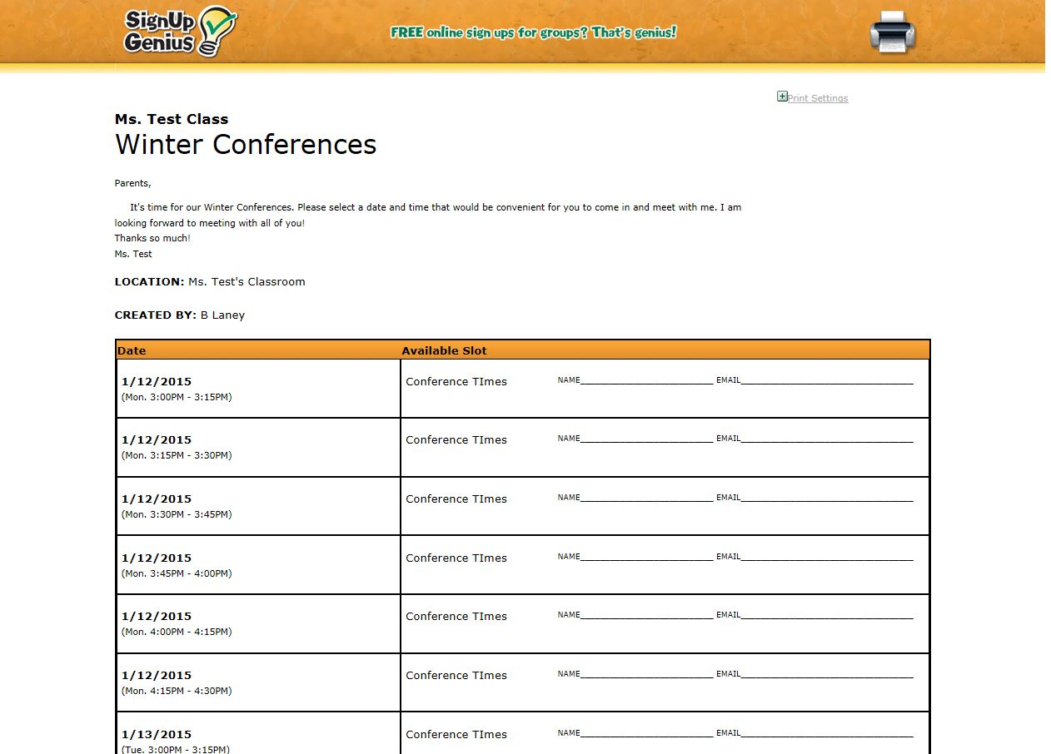
3. Once you select to have it published, you will be given a link that takes you directly to the form. You may use this link to email to your group if you did not enter their email addresses to receive the messages.
4. Once the link to the form has been emailed out, you will receive emails when participants sign-up. There is also a printable version that you may print out for reference if you need it.

Slide 15
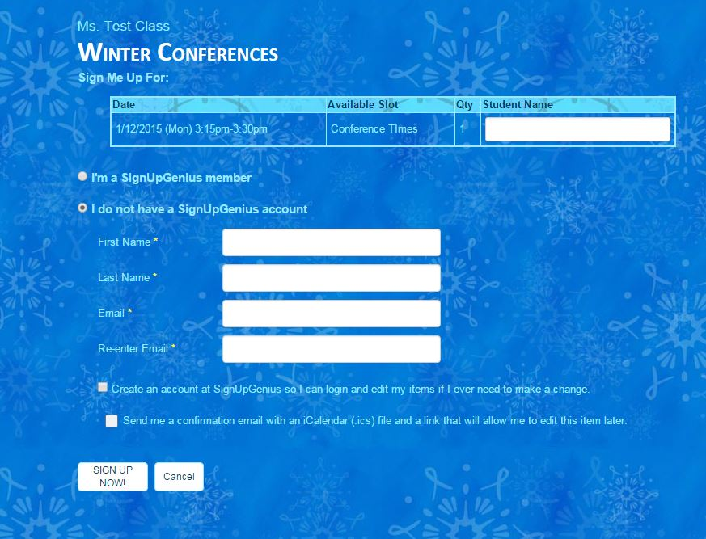
Participant Sign-up:
1. To sign-up, the participants simply click on a time slot, fill in their information and hit submit.
2. They enter their name and email address. They do not have to set up an actual account to be able to sign up.

Slide 16
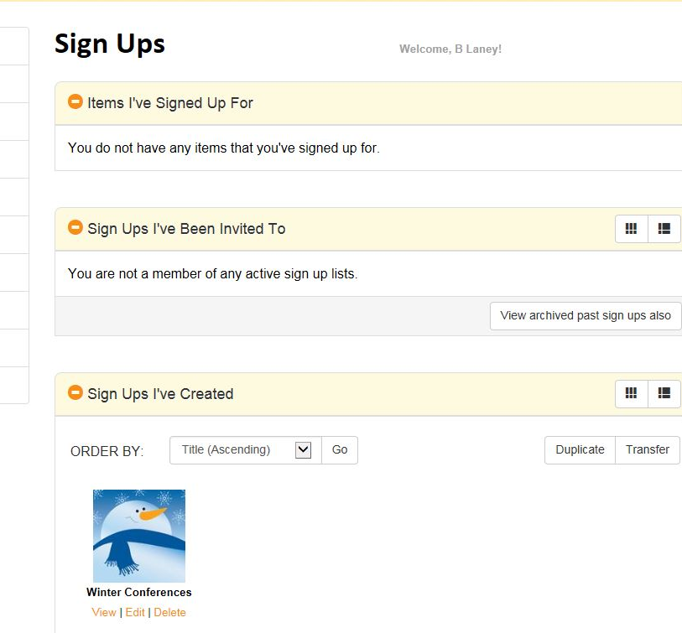
Editing or deleting a form:
1. You can make changes to a sign-up form at any time. Simply log-in to your account, select the form, and make the changes. You can add or delete times and dates.

Slide 17
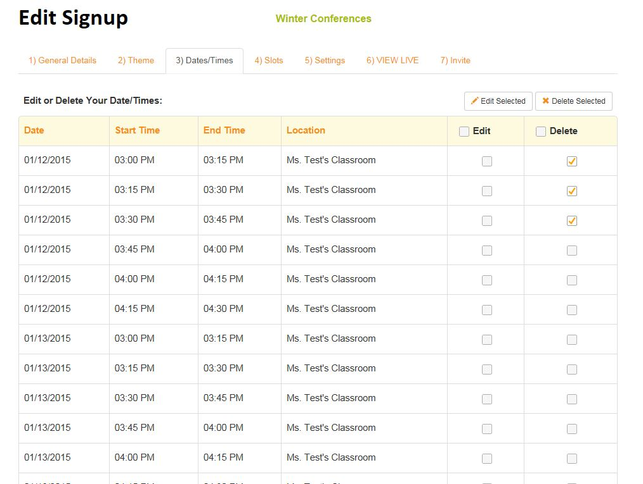
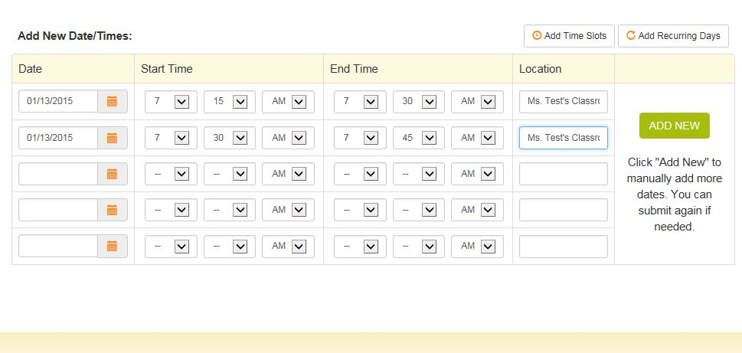
2. From your home page, select the sign-up form you wish to work with and click edit. You may also delete it at any time by clicking delete.
3. Once you click edit, you can go to the area you would like to edit. For example, if you have afterschool duty two days and can’t meet at certain times, you may want to delete those time slots from the list. If you would like to add a couple of early morning times, add them individually.

Slide 18
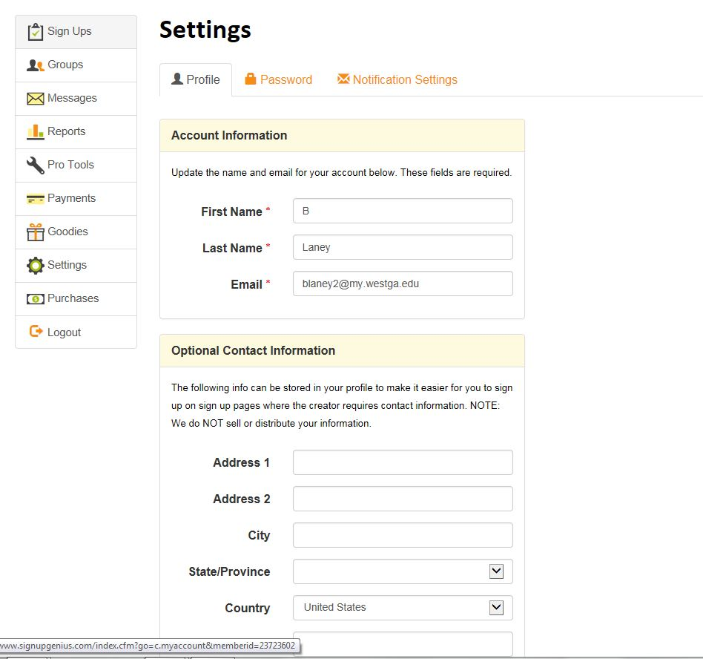
3. This PD just covered the basics of the program. Once you get the hang of it, explore and see what else you may learn to do. There are many different options.
4. You may edit your personal account at any time by clicking on the settings tab on the left side of the screen.

Slide 19
troubleshooting
For Troubleshooting or Questions:
Email: laneybs@yahoo.com
or blaney@pcboe.net

