Slide 1
Remind
Online Texting Tool
Created By: Brandi Laney

Slide 2
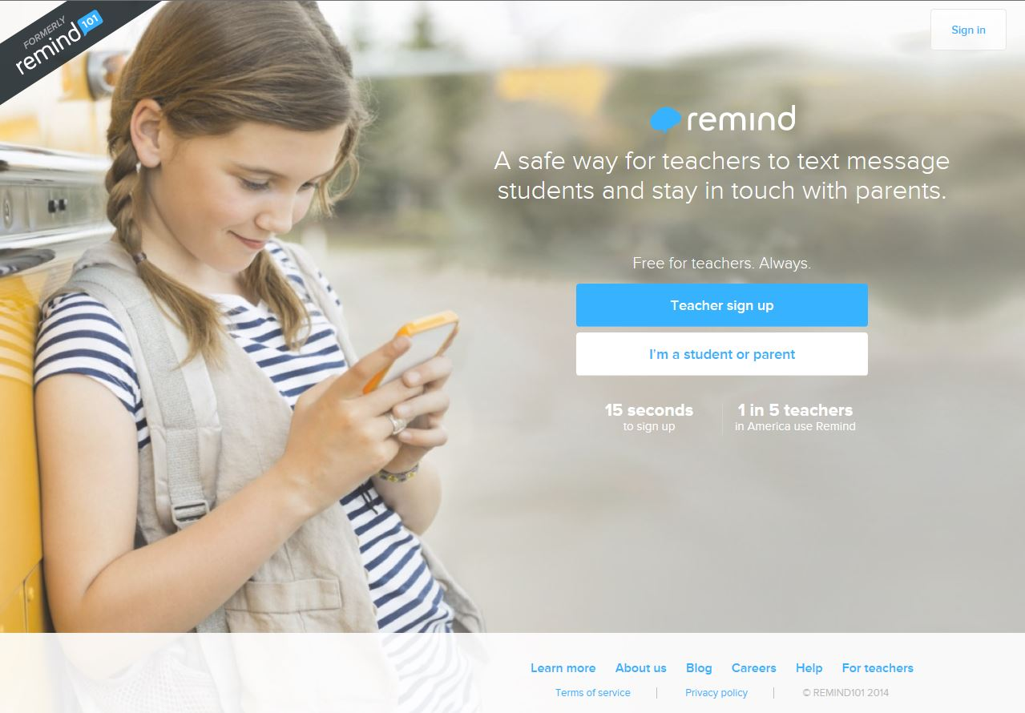
What is Remind?
Formerly “Remind 101”, Remind is a safe and secure way for teachers to connect with their parents and students. It is a texting system which allows the teacher to send a text without showing anyone’s actual phone number. It is a one-way type of communication and can be a great way to send out information. It is quick and easy to use.

Slide 3
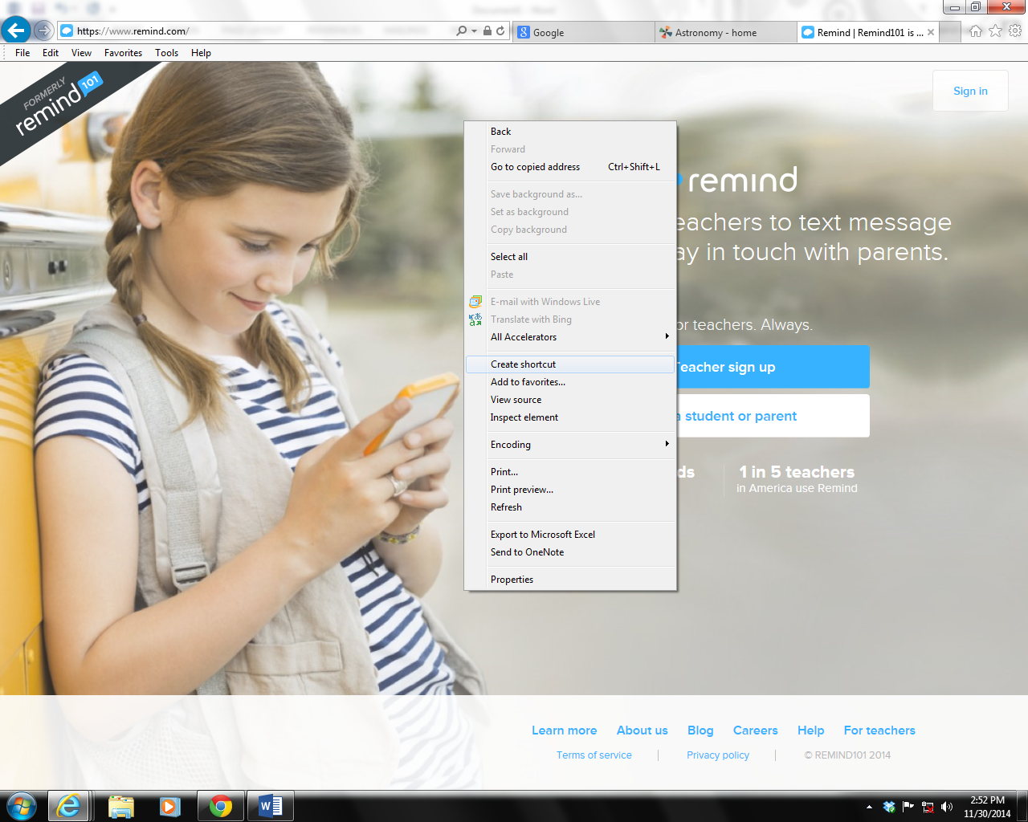
Signing -up or signing-in:
1. Go to the site https://www.remind.com/
2. Create a short cut for your desktop by right-clicking anywhere in the screen, and selecting create a shortcut.

Slide 4
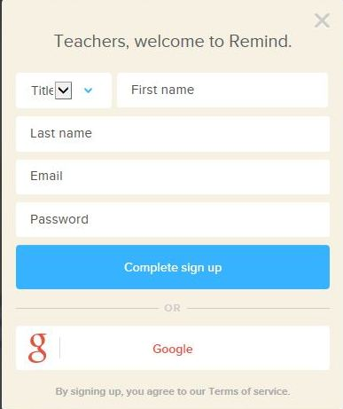
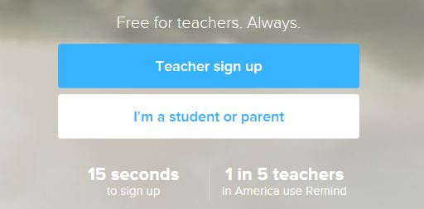
3. If this is your first visit, please follow steps 4-5 to set up an account. If you have an account, click “sign-in”.
4. Click on Teacher sign up
5. Fill in the information, click complete sign up

Slide 5
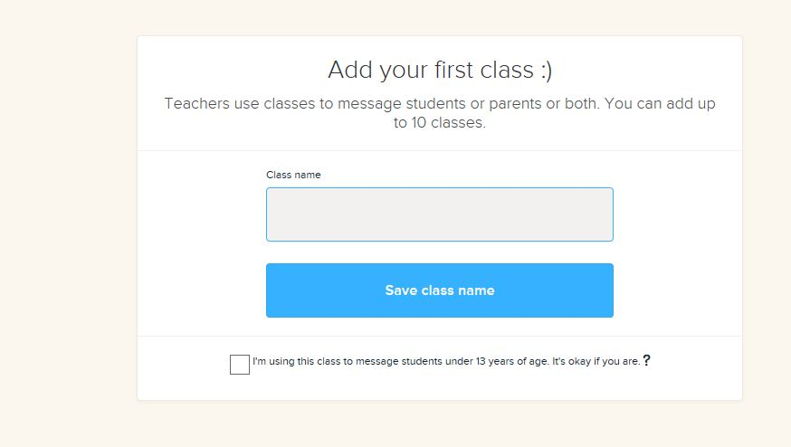
Creating a class:
1. Add your class and click save class name. (You can have more than one at a time.)

Slide 6
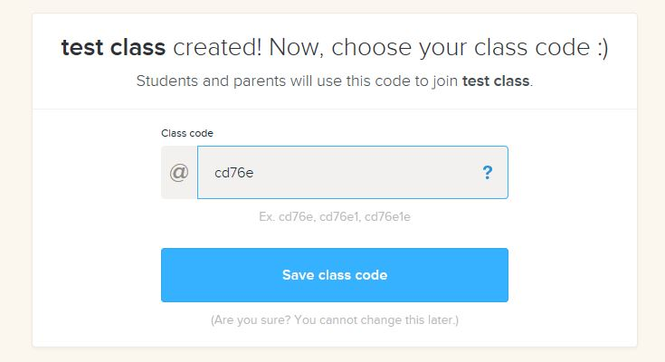
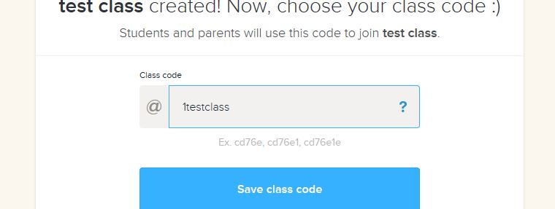
2. You will be given a class code or you may change it to something specific by clicking in the box and typing your own. Then click Save class code.
Computer generated code:
New class code:
3. You will be prompted to take a tour of the Remind site, or you can skip it and do it later if you wish.

Slide 7
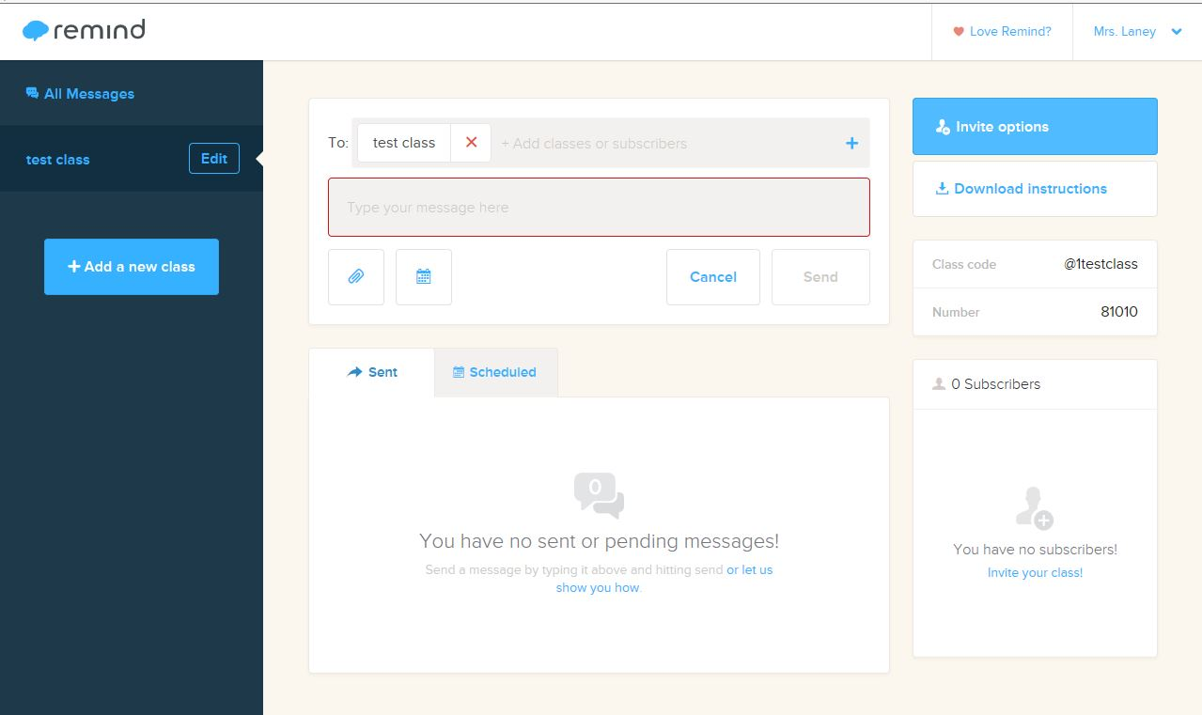
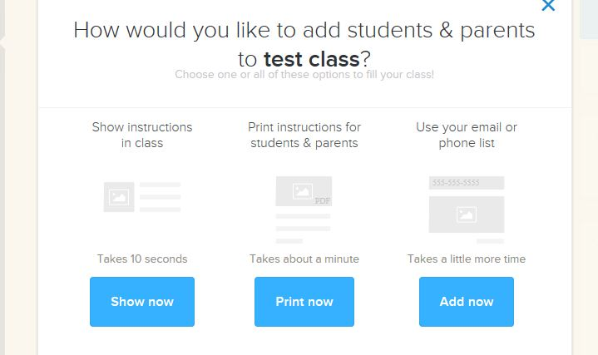
Inviting subscribers & joining:
1. Invite others to join your class by clicking on the Invite Options tab on the top right.
2. There are three options for getting instructions to your parents and/or students. Choose which option best suits your situation.

Slide 8
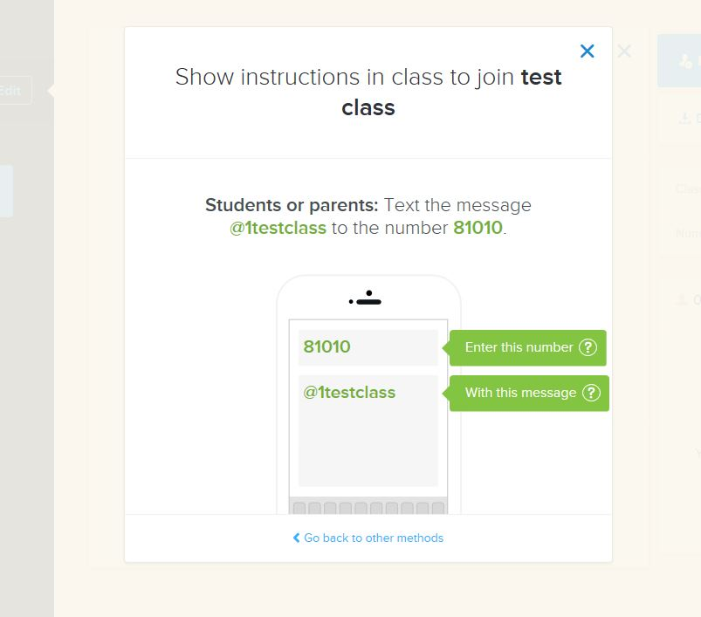
3. Join yourself by sending a text message to the provided number, then putting in the class code in the message space. DON’T’ FORGET TO INCLUDE THE @ SYMBOL IN THE MESSAGE.

Slide 9
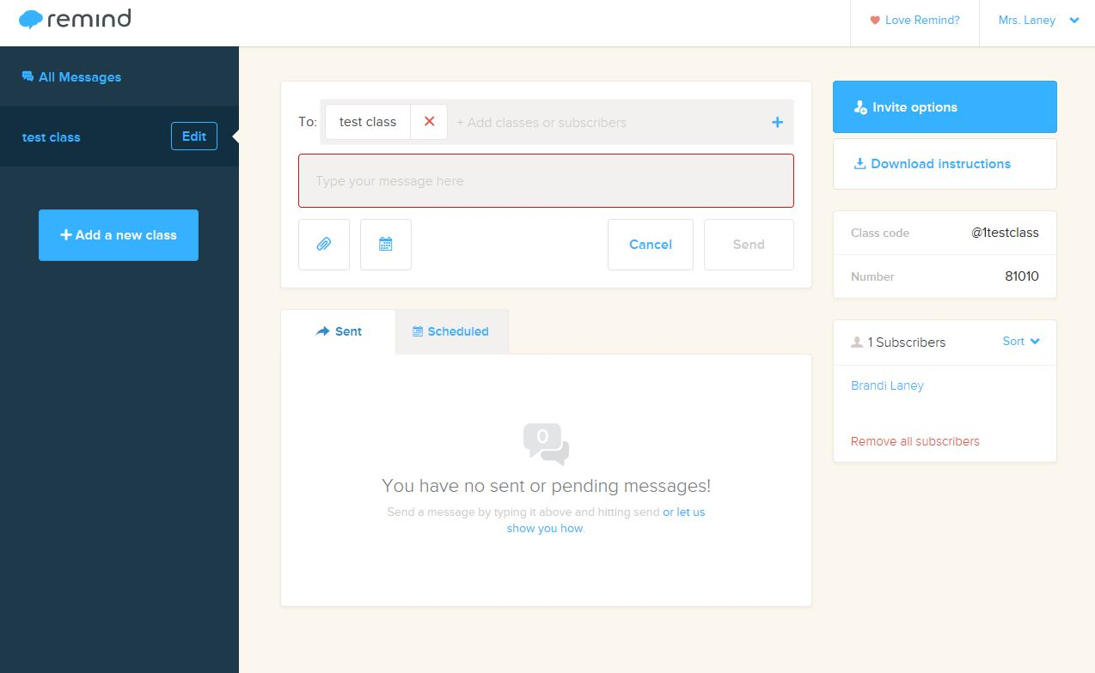
4. You will receive a text back on your phone asking for your name. Once you send your name back, you will be signed up. Your name should appear in the section under subscribers. Each time a person joins your “class” his or her name will appear under the subscribers.
*If you have ever joined Remind 101 yourself for another class in the past using the same cell phone, it will not ask for your name.

Slide 10
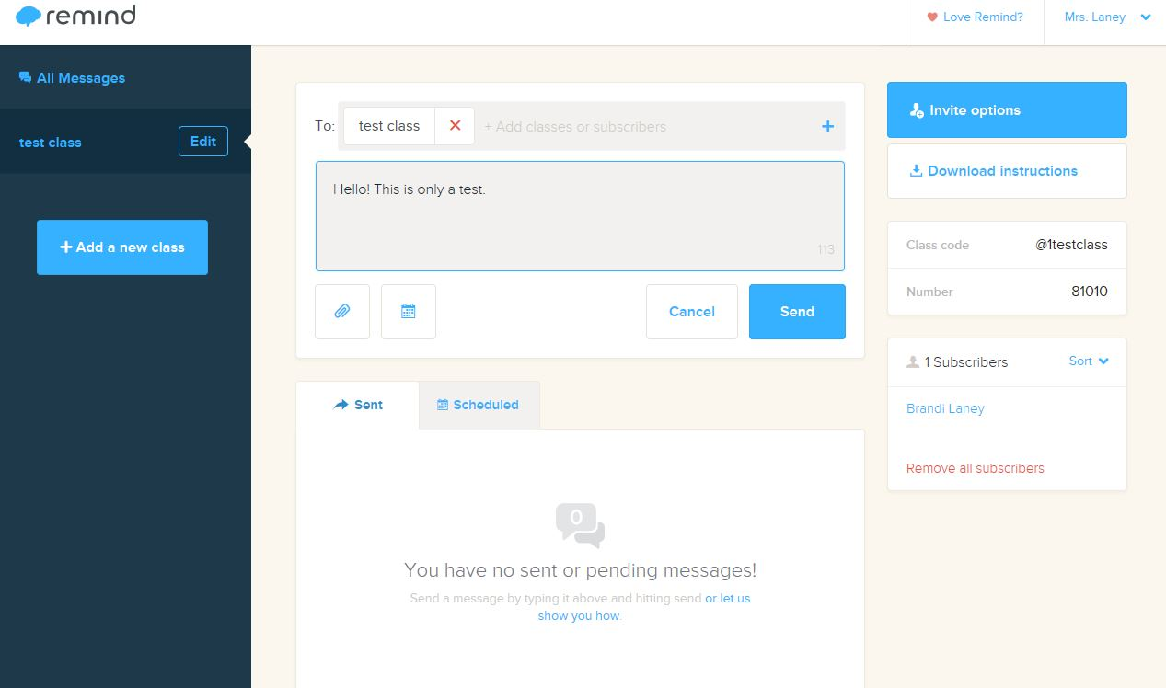
Sending a message:
1. Enter your message into the message space. You do have a limited number of characters that can be entered, so make your message informative, but brief.

Slide 11
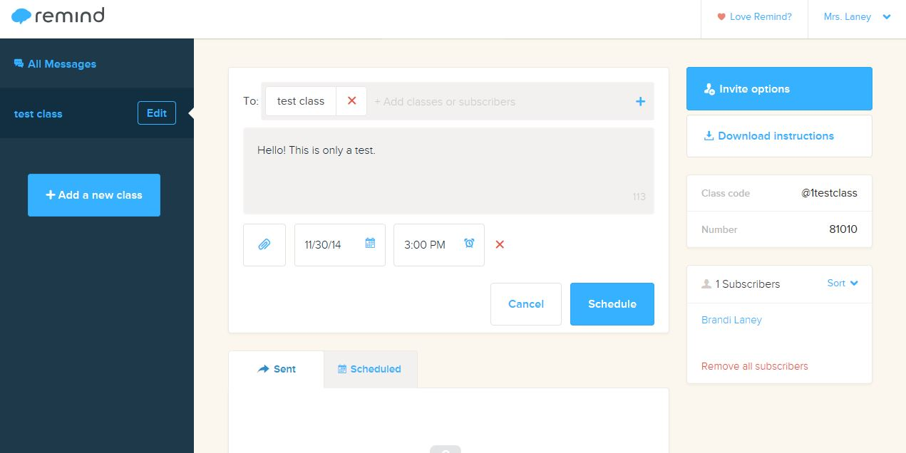
2. Once it is complete, you may click send. You may also select a specific date and time if you would like the message sent at a later time by clicking on the calendar icon under the message box. You may even attach a file by clicking on the paper clip icon under the message box.

Slide 12
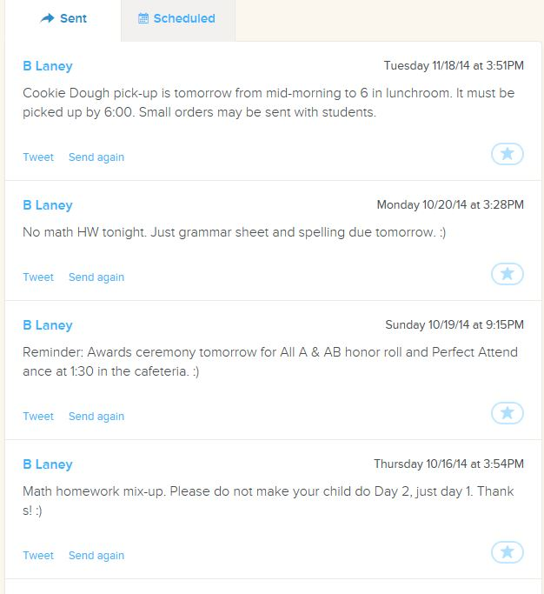
4. Your subscribers will receive a text message showing your name (usually Mr. or Mrs. and your last name you entered when you signed up) and the message only. It will not display any numbers, and the subscribers cannot reply back. It is for information only.
5. Your messages will be saved in your “message history” for reference purposes. You may resend them at any time.

Slide 13
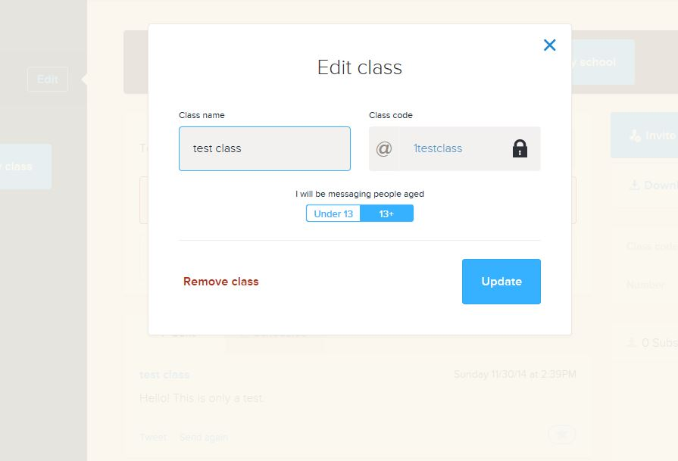
Editing or deleting:
1. To delete a class, start with deleting the Subscribers first by clicking on remove all subscribers on the right.
2. Click on the edit button beside the name of the class you wish to edit or delete. You may change the class name, but not the class code.
3. To delete the class, click delete.

Slide 14
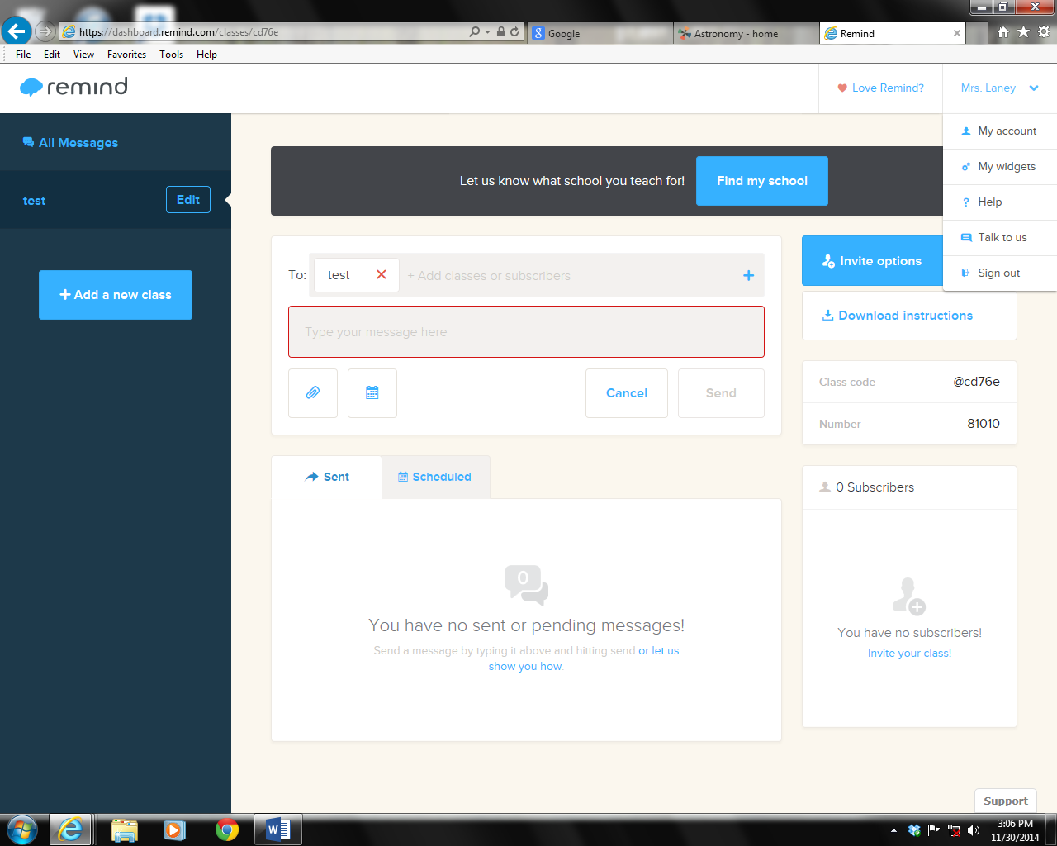
4. You may edit your personal account at any time by clicking on the arrow beside your name at the top right of the screen, then selecting “my account”. You may change your personal information, and also delete your account.

Slide 15
Troubleshooting:
For Troubleshooting or Questions:
Email: laneybs@yahoo.com
or blaney@pcboe.net

